Slide 1
Connection and Transmission Attacks
CS 5352/6352 Computer Security
Lecture note
Dr. Sajedul Talukder

Slide 2
Common Attacks
Buffer Overflows
IP Spoofing
Denial-of-Service Attacks
ARP Poisoning
DNS Poisoning
Eavesdropping
Session Hijacking
Password Cracking

Slide 3
What is Buffer Overflow?
A buffer overflow, or buffer overrun, is an anomalous condition where a process attempts to store data beyond the boundaries of a fixed-length buffer.
Recall that the idea is to feed a server a string that is too big for a buffer.
This string overflows the buffer and overwrites the return address on the stack.
Assuming we put our small program in the string, we need to know it’s address.

Slide 4
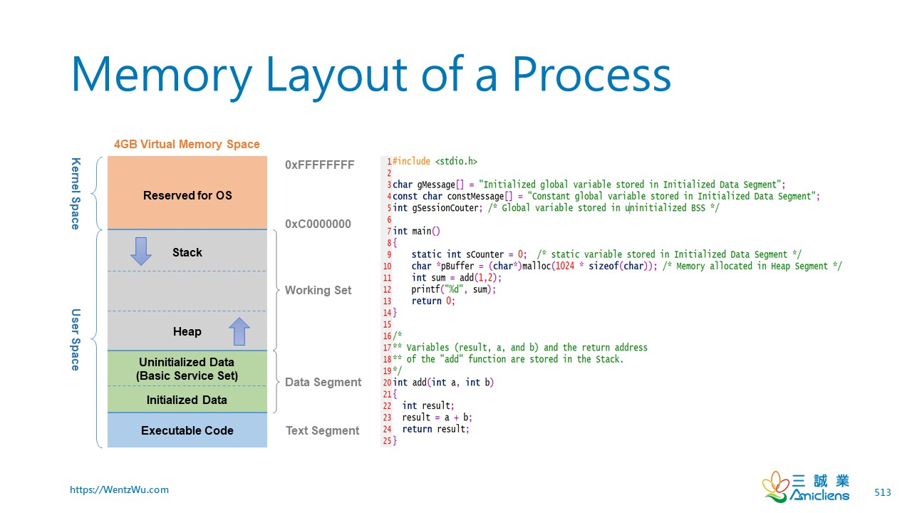
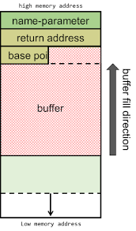
What is Buffer Overflow?

Slide 5
What are buffer overflows?
Suppose a web server contains a function:
char a[30];
void func(char *str) {
char buf[128];
strcpy(buf, str); strcpy(a, str); do-something(buf);
}
When the function is invoked the stack looks like:
What if *str is 136 bytes long? After strcpy:
top
of
stack
buf
sfp
ret-addr
str
Lower memory address
Buf+132
top
of
stack
Ret*
str
*str sfp*
Direction of copy operation

Slide 6
Basic Stack Exploit
Main problem: no range checking in strcpy().
Suppose *str is such that after strcpy stack looks like:
When func() exits, the user will be given a shell !!
Note: attack code runs in stack.
To determine ret guess position of stack when func() is called.
top
of
stack
*str ret Code for P
Program P: exec( “/bin/sh” )
(exact shell code by Aleph One)

Slide 7
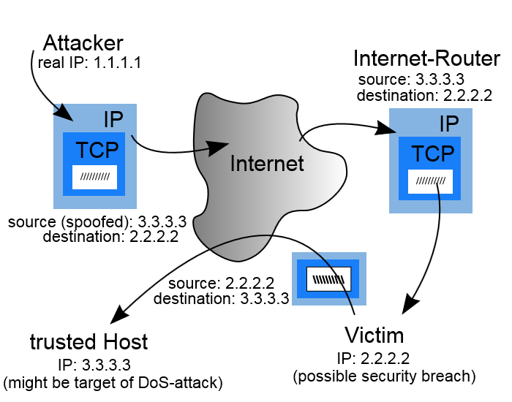
IP Spoofing
The creation of IP packets with a forged source.
The purpose of it is to conceal the identity of the sender or impersonating another computing system.
Uses of IP Spoofing
  Denial-of-service attack
    the goal is to flood the victim with overwhelming amounts of traffic. This prevents an internet site or service from functioning efficiently or at all, temporarily or indefinitely.
  To defeat networks security
    Such as authentication based on IP addresses.
    This type of attack is most effective where trust relationships exist between machines.

Slide 8
Denial-of-service (DoS)
Denial-of-service (DoS) attack aims at disrupting the authorized use of networks, systems, or applications
  by sending messages which exhaust service provider’s resources ( network bandwidth, system resources, application resources)
Examples: Ping flood, Smurf DoS, SYN Flooding, DDoS
Victims of (D)DoS attacks
  service-providers (in terms of time, money, resources, good will)
  legitimate service-seekers (deprived of availability of service itself)
  Zombie systems(Penultimate and previous layers of compromised systems in DDoS)

Slide 9
Who? What for?
The ulterior motive
  Earlier attacks were proofs of concepts or simple pranks
  Pseudo-supremacy feeling (of defaulters) upon denying services in large scale to normal people
    DoS attacks on Internet chat channel moderators
  Eye-for-eye attitude
  Political disagreements
  Competitive edge
  Revenge
Major lack of data on perpetrators and motives
Levels of attackers
  Highly proficient attackers who are rarely identified or caught
  Script-kiddies

Slide 10
Why should we care?
As per 2006 CSI/FBI Computer Crime and Security Survey
  25% of respondents faced some form of DoS attacks in previous 12 months. This value varied from 25% to 40% over the course of time
  DoS attacks are the 5th most costly form of attacks
A DoS attack is not just missing out on the latest sports scores or Tweets or weather reports
Internet is now a critical resource whose disruption has financial implications, or even dire consequences on human safety
  Cybercrime and cyberwarfare might use of DoS or DDoS as a potential weapon to disrupt or degrade critical infrastructure
  DDoS attacks are a major threat to the stability of the Internet

Slide 11
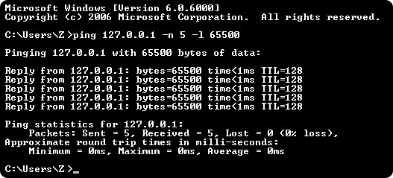
Ping flood attack
Ping flood, also known as ICMP flood, is a common Denial of Service (DoS) attack in which an attacker takes down a victim’s computer by overwhelming it with ICMP echo requests.
Use of ping command options -n –l (windows) or -n –s (linux)
Ping of Death

Slide 12
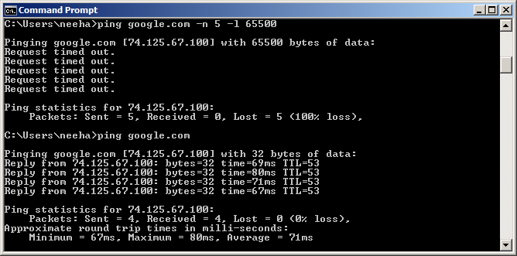
Ping flood attack cont’d ….
Generally useless on larger networks or websites, request timed out

Slide 13
Smurf DoS Attack
Send ping request to brdcst addr (ICMP Echo Req)
Lots of responses:
  Every host on target network generates a ping reply (ICMP Echo Reply) to victim
  Ping reply stream can overload victim
1 ICMP Echo Req
Src: Dos Target
Dest: brdct addr
3 ICMP Echo Reply
Dest: Dos Target
gateway
DoS
Target
DoS
Source
Prevention: reject external packets to brdcst address.

Slide 14
SYN Flooding Attack
90% of DoS attacks use TCP SYN floods
Streaming spoofed TCP SYNs
Takes advantage of three way handshake
Server saves “half-open” connections
These build up… until queue is full and all additional requests are blocked

Slide 15
TCP Connection Management
Three way handshake:
Step 1: client host sends TCP SYN segment to server
  specifies initial seq #
  no data
Step 2: server host receives SYN, replies with SYNACK segment
  server allocates buffers
  specifies server initial seq. #
Step 3: client receives SYNACK, replies with ACK segment, which may contain data
Recall: TCP sender, receiver establish “connection” before exchanging data segments
initialize TCP variables:
  seq. #s
  buffers, flow control info (e.g. RcvWindow)
client: connection initiator
server: contacted by client

Slide 16
SYN Flooding Explained
Attacker sends many connection requests with spoofed source addresses
Victim allocates resources for each request
  New thread, connection state maintained until timeout
  Fixed bound on half-open connections
Once resources exhausted, requests from legitimate clients are denied
This is a classic denial of service attack
  Common pattern: it costs nothing to TCP initiator to send a connection request, but TCP responder must spawn a thread for each request - asymmetry!

Slide 17
SYN Flooding Landscape
SYN Flooding
TCP Three Way Handshake for establish connection
C
S
C
S
SYN_{C1}
SYN_{C}
SYN_{C2}
Listening
Listening
Store state
SYN_{S1}, ACK_{C1+1}
SYN_{C3}
SYN_{S}, ACK_{C+1}
Store state
SYN_{S2}, ACK_{C2+1}
SYN_{C4}
Wait
SYN_{S3}, ACK_{C3+1}
SYN_{C5}
ACK_{S+1}
SYN_{S4}, ACK_{C4+1}
Connected
SYN_{S5}, ACK₅₁₊₁
The backlog queue is a large memory structure used to handle incoming packets with the SYN flag set until the moment the three-way handshake process is completed.
An operating system allocates part of the system memory for every incoming connection. Every TCP port can handle a defined number of incoming requests. The backlog queue controls how many half-open connections can be handled by the operating system at the same time.
When a maximum number of incoming connections is reached, subsequent requests are silently dropped by the operating system.

Slide 18
How to detect a TCP SYN attack
The netstat command shows how many connections are currently in the half-open state. The half-open state is described as SYN_RECEIVED in Windows and as SYN_RECV in Unix systems.
# netstat -n -p TCP
- tcp 0 0 10.100.0.200:21 237.177.154.8:25882 SYN_RECV
- tcp 0 0 10.100.0.200:21 236.15.133.204:2577 SYN_RECV
- tcp 0 0 10.100.0.200:21 127.160.6.129:51748 SYN_RECV
- tcp 0 0 10.100.0.200:21 230.220.13.25:47393 SYN_RECV
- tcp 0 0 10.100.0.200:21 236.219.139.207:49162 SYN_RECV
- tcp 0 0 10.100.0.200:21 238.100.72.228:37899 SYN_RECV - ...
How many half-open connections are in the backlog queue at the moment can be counted. In the example below, 769 connections (for TELNET) in the SYN RECEIVED state are kept in the backlog queue.
  # netstat -n -p TCP | grep SYN_RECV | grep :23 | wc -l 769
It is important to note that every TCP port has its own backlog queue, but only one variable of the TCP/IP stack controls the size of backlog queues for all ports.

Slide 19

Distributed Denial of Service
Distributed denial-of-service (DDoS) attacks employ multiple (dozens to millions) compromised computers to perform a coordinated and widely distributed DoS attack
Zombies
Attacker
Handler
Victim
Russia
Bulgaria
United
States
Can barrage a victim server with requests, causing the network
to fail to respond to anyone
Zombies
Notes:
The terms ‘bot’ and ‘zombie’ are apparently interchangeable. A ‘botnet’ is a large number of bots (or zombies) used for DDOS attacks.

Slide 20
Distributed DOS
Stacheldraht is a classic example of a DDoS tool.
BadGuy
Unidirectional commands
Handler
Handler
Handler
Coordinating communication
Agent
Agent
Agent
Agent
Agent
Agent
Agent
Agent
Agent
Agent
Attack traffic
Victim
Notes:
Why such hierarchy?
Stacheldraht is a classic example of a DDoS tool. It utilizes a layered structure where the attacker uses a client program to connect to handlers, which are compromised systems that issue commands to the zombie agents, which in turn facilitate the DDoS attack. Agents are compromised via the handlers by the attacker, using automated routines to exploit vulnerabilities in programs that accept remote connections running on the targeted remote hosts. Each handler can control up to a thousand agents.[1]

Slide 21

The DDoS Landscape

Slide 22
Preventing Denial of Service
DoS is caused by asymmetric state allocation
  If responder opens new state for each connection attempt, attacker can initiate thousands of connections from bogus or forged IP addresses
Cookies ensure that the responder is stateless until initiator produced at least two messages
  Responder’s state (IP addresses and ports of the connection) is stored in a cookie and sent to initiator
  After initiator responds, cookie is regenerated and compared with the cookie returned by the initiator

Slide 23
SYN Cookies
C
S
SYN_{C}
Listening…
Compatible with standard TCP;
simply a “weird” sequence number scheme
SYN_{S}, ACK_{C}
sequence # = cookie
Does not store state
F(source addr, source port,
dest addr, dest port,
coarse time, server secret)
Cookie must be unforgeable
and tamper-proof
Client should not be able
to invert a cookie
F=Rijndael or crypto hash
ACK_{S}(cookie)
Recompute cookie,
compare with with the one
received, only establish
connection if they match
More info: http://cr.yp.to/syncookies.html

Slide 24
Eavesdropping
Eavesdropping is the process of gathering information from a network by snooping on transmitted data.
To eavesdrop is to secretly overhear a private conversation over a confidential communication in a not legally authorized way.
The information remains intact, but its privacy is compromised.
Notes:
A method employing experimentation, evaluation, and trial-and-error methods to learn, discover, understand, or solve problems.
In DDB Heuristic work on simulate all possible solution by creating a space of strategies and then try to find the best solution.

Slide 25
Physical Eavesdropping
Process of listening in or overhearing parts of a conversation, this includes attackers listening in on your network traffic.
Passive attack
  Example: co-worker may overhear your dinner plans because your speaker phone is set too loud
Active attack
  Collecting data that passes between two systems on a network
Type of Eavesdropping:
    Inspecting the dumpster,
    Recycling bins,
    File cabinets for something interesting

Slide 26
Eavesdropping over wired networks
Over wired networks eavesdropping is more difficult
It needs the eavesdropper to tap the network, using a network tap which is a hardware device that provides a way to access the data flowing across the network.
Can’t be achieved unless the eavesdropper can be in touch with the wire of the network which is difficult sometimes and impossible the other times.

Slide 27
Eavesdropping over wireless networks
Easier to be achieved (no compromised dangerous).
You need
A computer with wireless network adapter working on promiscuous mode
To be in the area of the wireless network coverage
To have one of the particular software tools that allows the eavesdropping over Wi-Fi. Commercial name for the 802.11 products.

Slide 28
Session Hijacking
TCP session hijacking is a security attack on a user session over a protected network.
The most common method of session hijacking is called IP spoofing, when an attacker uses source-routed IP packets to insert commands into an active communication between two nodes on a network and disguising itself as one of the authenticated users.
Another type of session hijacking is known as a man-in-the-middle attack, where the attacker, using a sniffer, can observe the communication between devices and collect the data that is transmitted.

Slide 29
TCP Session Hijacking
TCP connection has both sequence number and acknowledge number in each packet.
The two ends negotiate what seq. and ack. Numbers to be used in TCP set up stage.
seq and ack number size: 2³²
  Makes seq/ack guessing very hard to achieve
  Very hard to hijack an already setup TCP connection!
client
server
SYN,
seq=client_seq
SYN/ACK,
seq=server_seq, ack=client_seq+1
ACK,
seq=client_seq+1
ack=server_seq+1

Slide 30
TCP Session Hijacking
Possible when an attacker is on the same network segment as the target machine.
  Attacker can sniff all back/forth tcp packets and know the seq/ack numbers.
  Attacker can inject a packet with the correct seq/ack numbers with the spoofed IP address.
    IP spoofing needs low-level packet programming, OS-based socket programming cannot be used!

Slide 31
TCP Session Hijacking
Due to
ARP spoofing

Slide 32
How to Prevent Session Hijacking
ARP must not be spoofed
Session Identifiers Should Be Unique
Session Identifiers Should Not be Guessable
Session Identifiers Should Be Independent
Session Identifiers Should be Mapped with Client-Side Connections

Slide 33
IP Address and MAC Address Analogy
IP address
  To guide delivery to destination host across the Internet (across multiple networks)
MAC Address
  To guide delivery between two hosts, two routers, and a host and router within a single subnet
  Same LAN, Frame Relay network, etc.
In company, each person has a company-wide ID number (like IP address)
In company, person also has a local office number in a building
Paychecks are made out to ID numbers
For delivery, also need to know office number

Slide 34
Address Resolution
Problem: Given an IP address find the MAC address
  Router knows that destination host is on its subnet based on the IP address of an arriving packet
  Does not know the destination host’s MAC address, so cannot deliver the packet across the subnet
Destination Host
128.171.17.13
Subnet
MAC address?

Slide 35
Address Resolution Protocol (ARP)
Router creates an ARP Request message to be sent to all hosts on the subnet.
  Address resolution protocol message asks “Who has IP address 128.171.17.13?”
  Passes ARP request to data link layer process for delivery
Subnet
ARP Request

Slide 36
Address Resolution Protocol (ARP)
Data link process of router broadcasts the ARP Request message to all hosts on the subnet.
Host with IP address 128.171.17.13 responds
  Internet process creates an ARP response message
  Contains the destination host’s subnet address (48-bit MAC address on a LAN)
Router delivers the IP packet to the destination host
ARP Response
Subnet

Slide 37
ARP: Address Resolution Protocol
How to avoid broadcasting ARP request every time?
Solution 1. Table Lookup:
Searching or indexing to get MAC addresses
237.196.7.78
1A-2F-BB-76-09-AD
237.196.7.23
237.196.7.14
LAN
Each IP node (Host, Router) on LAN has ARP table
ARP Table: IP/MAC address mappings for some LAN nodes
71-65-F7-2B-08-53
58-23-D7-FA-20-B0
0C-C4-11-6F-E3-98
237.196.7.88

Slide 38
ARP
ARP works by broadcasting requests and caching responses for future use
The protocol begins with a computer broadcasting a message of the form
who has <IP address1> tell <IP address2>
When the machine with <IP address1> or an ARP server receives this message, its broadcasts the response
<IP address1> is <MAC address>
The requestor’s IP address <IP address2> is contained in the link header
The Linux and Windows command arp - a displays the ARP table
  Internet Address Physical Address Type
  128.148.31.1 00-00-0c-07-ac-00 dynamic
  128.148.31.15 00-0c-76-b2-d7-1d dynamic
  128.148.31.71 00-0c-76-b2-d0-d2 dynamic
  128.148.31.75 00-0c-76-b2-d7-1d dynamic
  128.148.31.102 00-22-0c-a3-e4-00 dynamic
  128.148.31.137 00-1d-92-b6-f1-a9 dynamic
Notes:
IPv6 does not use ARP, and ARP is instead replaced by Neighbor Discovery Protocol.

Slide 39
ARP Caches
IP: 192.168.1.1
MAC: 00:11:22:33:44:01
IP: 192.168.1.105
MAC: 00:11:22:33:44:02
Data
192.168.1.1 is at 00:11:22:33:44:01
192.168.1.105 is at 00:11:22:33:44:02
ARP Cache
192.168.1.105 | 00:11:22:33:44:02
ARP Cache
192.168.1.1 | 00:11:22:33:44:01

Slide 40
ARP Poisoning
The ARP table is updated whenever an ARP response is received
Requests are not tracked
ARP announcements are not authenticated
Machines trust each other
A rogue machine can spoof other machines
According to the standard, almost all ARP implementations are stateless

Slide 41
ARP Poisoning
An arp cache updates every time that it receives an arp reply… even if it did not send any arp request!
It is possible to “poison” an arp cache by sending gratuitous arp replies

Slide 42
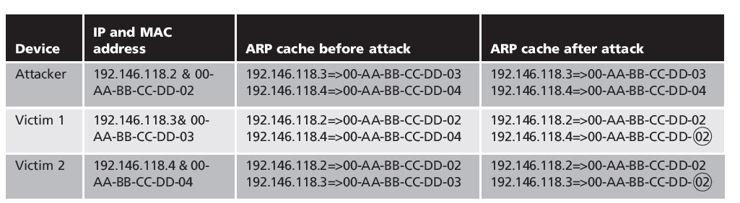
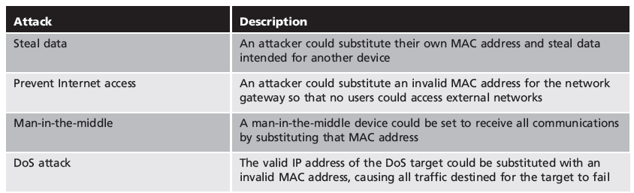
Poisoned ARP Caches
  Attacker modifies MAC address in ARP cache to point to different computer
  Attacks from ARP poisoning

Slide 43
Poisoned ARP Caches
(man-in-the-middle attack)
192.168.1.106
00:11:22:33:44:03
Data
Data
192.168.1.105 is at 00:11:22:33:44:03
192.168.1.1 is at 00:11:22:33:44:03
192.168.1.1
00:11:22:33:44:01
192.168.1.105
00:11:22:33:44:02
Poisoned ARP Cache
192.168.1.105 | 00:11:22:33:44:03
Poisoned ARP Cache
192.168.1.1 | 00:11:22:33:44:03

Slide 44
ARP Poisoning Solutions
Using static entries solves the problem but it is almost impossible to manage!
Check multiple occurrence of the same MAC
  i.e., One MAC mapping to multiple IP addresses (see previous slide’s example)
Software detection solutions
  Anti-arpspoof, Xarp, Arpwatch

Slide 45
Basic Domain Name Resolution
Translates domain names into IP addresses
Every host knows a local DNS server
  Sends all queries to the local DNS server
If the local DNS can answer the query, then you’re done
  Local server is also the authoritative server for that name
  Local server has cached the record for that name
Otherwise, go down the hierarchy and search for the authoritative name server (root)
  Every local DNS server knows the root servers
  Use cache to skip steps if possible
    e.g. skip the root and go directly to .edu if the root file is cached

Slide 46
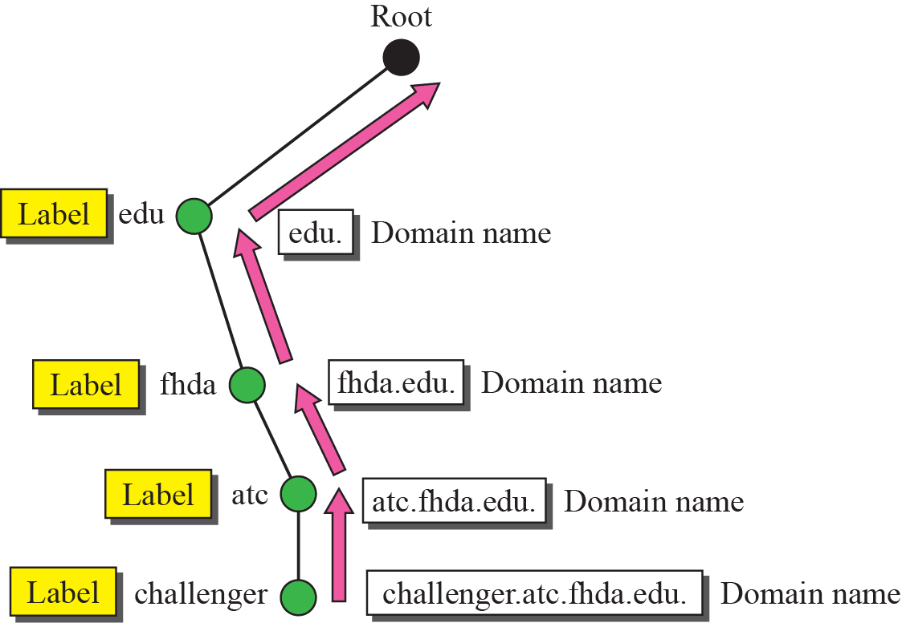
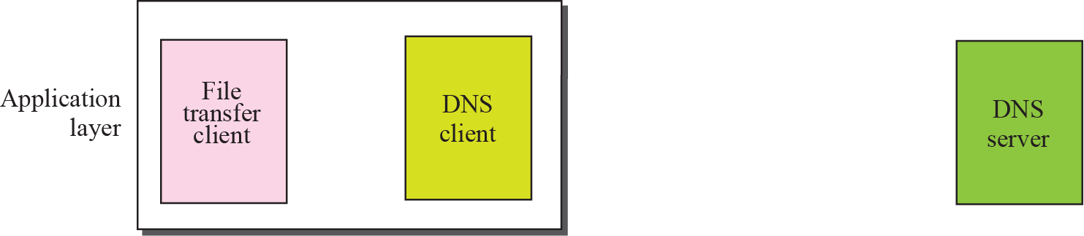
DNS Resolution
242.66.45.4

Slide 47


Local Name Servers
Where is google.com?
Northeastern
Each ISP/company has a local, default name server
Often configured via DHCP
Hosts begin DNS queries by contacting the local name server
Frequently cache query results

Slide 48
Authoritative Name Servers
www.neu.edu = 155.33.17.68
Where is www.neu.edu?
www.neu.edu
Northeastern
Root
edu
neu
Authority for ‘edu’
Authority for ‘neu.edu’
Stores the name→IP mapping for a given host

Slide 49
The Importance of DNS
The goal of DNS is relatively simple -- in general, words are easier for people to remember than long, confusing number sequences.
Without DNS…
  How could you get to any websites?
Your mailserver
  When you sign up for websites, you use your email address
  What if someone hijacks the DNS for your mail server?
DNS is the root of trust for the web
  When a user types www.bankofamerica.com, they expect to be taken to their bank’s website
  What if the DNS record is compromised?

Slide 50
DNS poisoning
DNS poisoning
  Domain Name System is current basis for name resolution to IP address
  DNS poisoning substitutes DNS addresses to redirect computer to another device
Two locations for DNS poisoning
  Local host table
  External DNS server

Slide 51
DNS poisoning

Slide 52
Questions?

